Slide 1

Doing Well and Giving Back
How to develop Self Sustainable Real Estate Projects applying Social Entrepreneurial Concept, Programming and theming Mindset
Firoz Shroff
Idea Sponsor and Founder
Social Entrepreneurship Consortium Inc..
Firoz.shroff@seconsortium.com
Jeffrey Lam
VP, Project Development
Social Entrepreneurship Consortium Inc.
jeffrey@seconsortium.com
Notes:
Good morning, L & G, - It is my utmost pleasure to be with you on invitation of Prof Guan. My presence here is not to give fancy numbers, statistics and structured document but to share our practical business experience and our gut feel. We believe these are exciting and wonderful times offering great opportunities to all of us to harness our intellectual capital through innovation to create wealth with social mindset. How we measure the size of opportunity in Canada, our total debt is $ 600 bill equivalent to Mkt Cap of Apple 3 months ago. Ordinary person can create wealth as huge as debt of G 7 country. Steve Jobs business was selling experience to end user; he measured the market not through research but through his insightful experience and gut feel. This barometer allowed and had opened doors for us to create mega wealth applied with social entrepreneurial mindset.
This 2 minute clip of the Blind man will give you insight to our perception. This video taught us a practical lesson that people can pass by and cannot or can see opportunities but with different perspective based on their knowledge and experiences.
Our whole lifecycle is base around harnessing new ways of originating opportunities to benefit society and ourselves. Why society first – we are a as strong as a society
We harnessed our mind and created mega project Markham Wellness District and The International Club of Canada: how we started this, our wealth innovation strategies and tactics, succession planning of the project and philanthropic application integrated with SE mindset which we started with very small capital. The 5 key factors we applied were information- intellectualization- imagination- integration and innovative thinking to create this unique framework for this Mega Project.

Slide 2
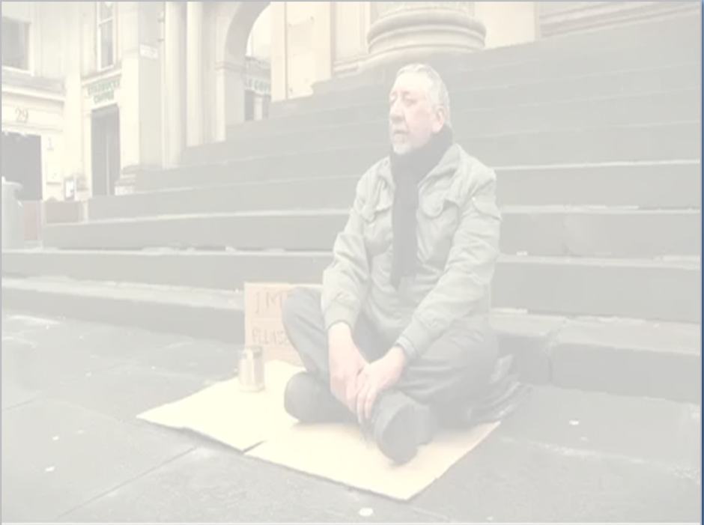
Our Scenario
The Story of the Blind Man
How We Apply
Social Entrepreneurial (SE) Mindset
To Originate Wealth
Notes:
When we are controlled by traditional environment the AURA of uncertainties prevails - It is important to get an outsider with new mindset to assist to change the strategy and to provide new dimension to wealth creation by inducting new perspectives

Slide 3
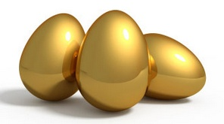
Our Mindset to Structure SE Deals
Invest HYBRID Capital and Maximum Intellectual and Branding Capital
($100K to $10M)
Founder's
Entrepreneurial
Capacity
Strategize
How to Create and Distribute
Social Capital
to add value
to asset
Create SE Returns
($10M to 00M from Projects
Notes:
Our perspective is to invest very minimum up-front capital to tie up a mega-value asset. – The lady creates an ecosystem for the blind man without giving a dollar but applying her intellectual capital to change the profit dynamics for him. This model has opened up a whole new world of involvement and opportunities for us. Our approach to investment is to induct hybrid capital of $ 1 mill what we normally call startup/seed/early stage capital to tie up transactions. We call it hybrid – “Highest yield by rotating integrated dollars” integrated with our 4 generation of mercantile practice. Turn the HYBRID capital with SE mindset to create mega return not 100% in 5 years but 100 times.

Slide 4
Benefits of Our Social Entrepreneurship “SE” Model
1. Astude Investment, Graceful ROI
2. Minimum Risk
3. Tax Planning Through Philanthropy
4. Empower Social and Intellectual Wealth
5.Creation of SE Wealth for all Stakeholders
Reasonable Return, Low Risk, Philanthropy & Intellectual Capacity Building Coming Together
Notes:
Minimal capital investment for max return on intellectual capital;
No financial risk on our part – DD is due diligence to us it is deal designing
Minimize tax liabilities via Philanthropy –We spend taxable dollars as Philanthropic investment
Contribute to society – Create educational Institution to teach new mindset – Example Shroff School of Social Entrepreneur-“SHIP” at York University
Pass intellectual thinking pattern to future generations via education– -Teach them not to fish but create fish pond so other can fish and everyone can feast

Slide 5
SE Deal Making Process applied to Markham
1% Financial Capital
($100K - $1M)
Acquire
Assets with Structured Financing
Create Values
With SE Mindset
Invite SE Partners as Investors
Entrepreneurial
Partnership
Social
Partnership
Attract
JV Partners –
From Entry to Exit Strategies
Long-Term Return
($ 10M -100M+)
Notes:
SE Our deal making process applied to Markham
Our deal making process
1. We intellectually source assets that have mega intrinsic values (Discuss Blind Man ecosystem) than through intelligent process extract the value to benefit all stakeholders
2. We then apply strategy to tie up the asset with minimum deposit and the longest closing time possible paying better price to the seller.
3. We optimize our time, using the due diligence period for deal designing
4. In deal designing, we innovate by inducting our International Entrepreneurial experience, Intellectual Capital, integrative knowledge, Social Attributes and various other value adding assets.
5. These, in turn, infuse the marketing, sales, sourcing partners to take partial exit strategy etc
6. Bringing all these elements together, we actualize the real values in the tied-down asset.
7. The Social Partnerships create greater value example York University – UNACTO – Diabetic Association – Hospital see 300000 visitors patients we changed the nomenclature to customer perspective
8. Compare this to the ‘blind man’ video: the passer-by gave the man no money at all. But change of sign or change of mind dramatically increased the blind man’s monetary value/cash-flow she “only” gave him a little time, and a new sign! That is how we like to invest and originate wealth – preservation of wealth through deal origination to create new wealth is the best protection!
9. In the next step, we find a financial partner to provide funding to close the deal
10. The money that the partner provides is literally more than the value of the property we bought
11. We offer the incoming partner upto 24% interest in the project Example MWD 24% for $ 24 mill
12. Our agenda in this first project phase is to make profit + retain majority interest in debt free property for next turn of development profit.
13. In the second phase – we find large institutions for more equity - public listing and bring development partner with design, builld operate and manage expertise.
14. In 3rd - phase we handover the project to best players to operate it for us.
15. In this phase we go to branded consultants to attract Billion dollar partners

Slide 6
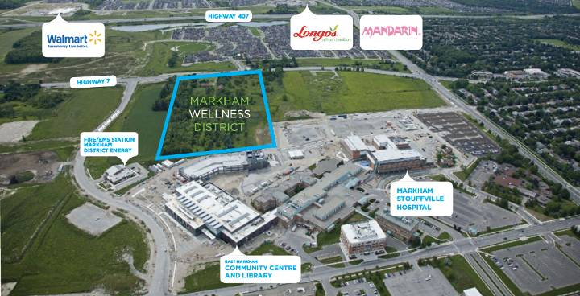
Our Case Study: The International Club of Canada (1st Phase of Markham Wellness District)
Aerial view of existing assets around the land we applied 20 (i) s to innovate a theme, concept and integration to create mega 3 mill sqft mixed used community project under Wellness District Umbrella and exited by passing the work to developers
Notes:
See assets around the land are more valuable than the land….once you buy the land than you integrate the power of others assets to create a mega asset

Slide 7
Multi-Billion Dollar Assets We Identified Around the Site to Create TICC and MWD
MARKHAM WELLNESS DISTRICT- MWD
Markham Stouffville Hospital provides Markham Wellness District ready made absorption – walk to work in wellness
Expansion will finish in 2013 at cost of $500 M with tax payers dollars, and will include a new Cornell Community Centre adjacent to Markham Wellness District.
Ready Market –Hospital 1,800 staff – 275 Physicians - New Staff 900 staff and 300 nurses – approx 300,000 visitors pa from region + Cornell Community planned as 30,000 in 10 years ( all TICC and MWD Customers)
120,000 cars park at the hospital per year ( place to market MWD) The traffic will increase with the expansion of the hospital and the opening of the East Markham Community Centre and Library providing customers for MWD
Largest Urban Rouge Park intellectually bought with Rouge Riding Bicycle
-

Slide 8
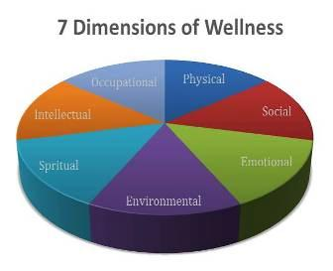
TICC and MWD is Themed Around 7 Dimensions of Wellness
Wellness means a balanced integration of Physical Existence and Human Aspirations for Individual and Group Satisfaction of the human spirit.
Our vision is to create a community in which people of all generations come to live together (parents- grandparents and grand kids) in an emotionally developed and diverse environment to pass wisdom of grandparents to coming generation not from Florida but by being around.
The Wellness theme focuses on the 7 Dimensions of Wellness in the context of cohesive living and overcoming “isolation” (Newtown USA case ) collectively applying 3 generational of living, loving, liking and learning wisdom to be together. Make isolation our friend through affection.
www.youtube.com/watch?v=5ydAk92favQ
Notes:
The 7 dimensions of wellness provide a lifecycle and lifestyle is part of it.

Slide 9
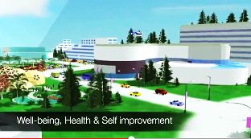
The Big Idea of TICC
The International Club of Canada
Innovated program of TICC as catalyst in the 1st phase in MWD to self-financed whole 2.5 mill sq ft by pre-selling 10,000 membership at $ 49,000 globally on 15 year payment plan. The TICC concept is designed around the Granite Club which has 11,000 members for local markets plus $40 M expansion, and 2 yrs. waiting list
TICC - One stop Platform for Social- Business –Personal - Financial- Philanthropic –Wellness for all Visitors including arrived and new immigrants professionals - Businessmen and families from Asia -Middle East and Europe- - Markham is hub for Asian Community
Notes:
Brief about TICC…..looking at the slide..How the cash flow is going to assist with the whole project.

Slide 10
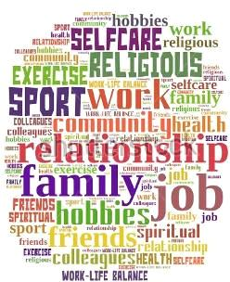
Proposed Features of MWD
End-to-End Life Cycle Amenities some example
Our proposed features for our wellness condo owners as a wholistic lifecycle.
Examples:
What is firescape staircase that is eco-friendly exercise area?
What is three generation living?
What is day care saving per annum for a family $ 25,000 pa?
What is organic farming 1 acres land for organic food to grow and barter?
What is internet home base business?
What is new consumer goods endorsement by
collective power of MWD residents?
What is free TICC membership?
What is live, work, learn wellness and play?
Notes:
Some example of what wellness means to us to provide to our condo owners

Slide 11
What is our Social Partnership
Jeffrey Lam attached for 8 year – learning
York University – New Campus
Markham Stouffville Hospital – Donation
Cornell Ratepayer (Homeowners) Association Empowerment
Notes:
Social Partnership comes in many forms shapes sizes

Slide 12
Our Philosophy
Wealth allows you the luxury to buy simplicity not complexity ”
-
"Wealth is when small efforts produce big socioeconomic results which we can share. Poverty is when big efforts produce small socioeconomic results with nothing to share."
judge a person's sincerity and honesty by his intellectual capacity
Learn to make millionaire to build a billionaire dollar enterprise
Do you know profits come in many shape and sizes? Do you know how to measure social profits with community involvement
Share your knowledge. It's a way to achieve immortality
SEC Team and Shroff Family
Notes:
Our philosophy

Slide 13

Q
Q & A
We need more grandmothers in court !!!
Why Lawyers should never ask a witness a question if they aren't prepared for the answer.......
In a trial, a Southern small town prosecuting attorney called his first witness to the stand ... a grand motherly, elderly woman. He approached her and asked, "Mrs. Jones, do you know me?"
She responded, "Why, yes I do know you, Mr. Williams. I've known you since you were a young boy, and frankly, you've been a big disappointment to me. You lie, you cheat on your wife, you manipulate people and talk about them behind their backs. You think you're a big shot when you haven't the brains to realize you never will amount to anything more than a two-bit paper pusher. Yes, I know you.“
The Lawyer was stunned. Not knowing what else to do, he pointed across the room and asked, "Mrs. Jones, do you know the defense attorney?"
She again replied, "Why yes, I do. I've known Mr. Bradley since he was a
youngster too. He's lazy, bigoted, and he has a drinking problem. He can't build a normal relationship with anyone and his law practice is one of the worst in the entire state. Not to mention he cheated on his wife with three different women, one of them was your wife. Yes, I know him." The defense attorney almost died.
The judge asked both counselors to approach the bench, and in a very quiet voice, said: "If either of you bastards asks her if she knows me, I'll throw your sorry asses in jail for contempt."

